Slide 1

DataTree
“Make like a tree, and leaf the rest to us”
By: Ian Siple
Alexander Wade
Jared Endicott
Huy Hoang
Ali Chowdhury

Slide 2



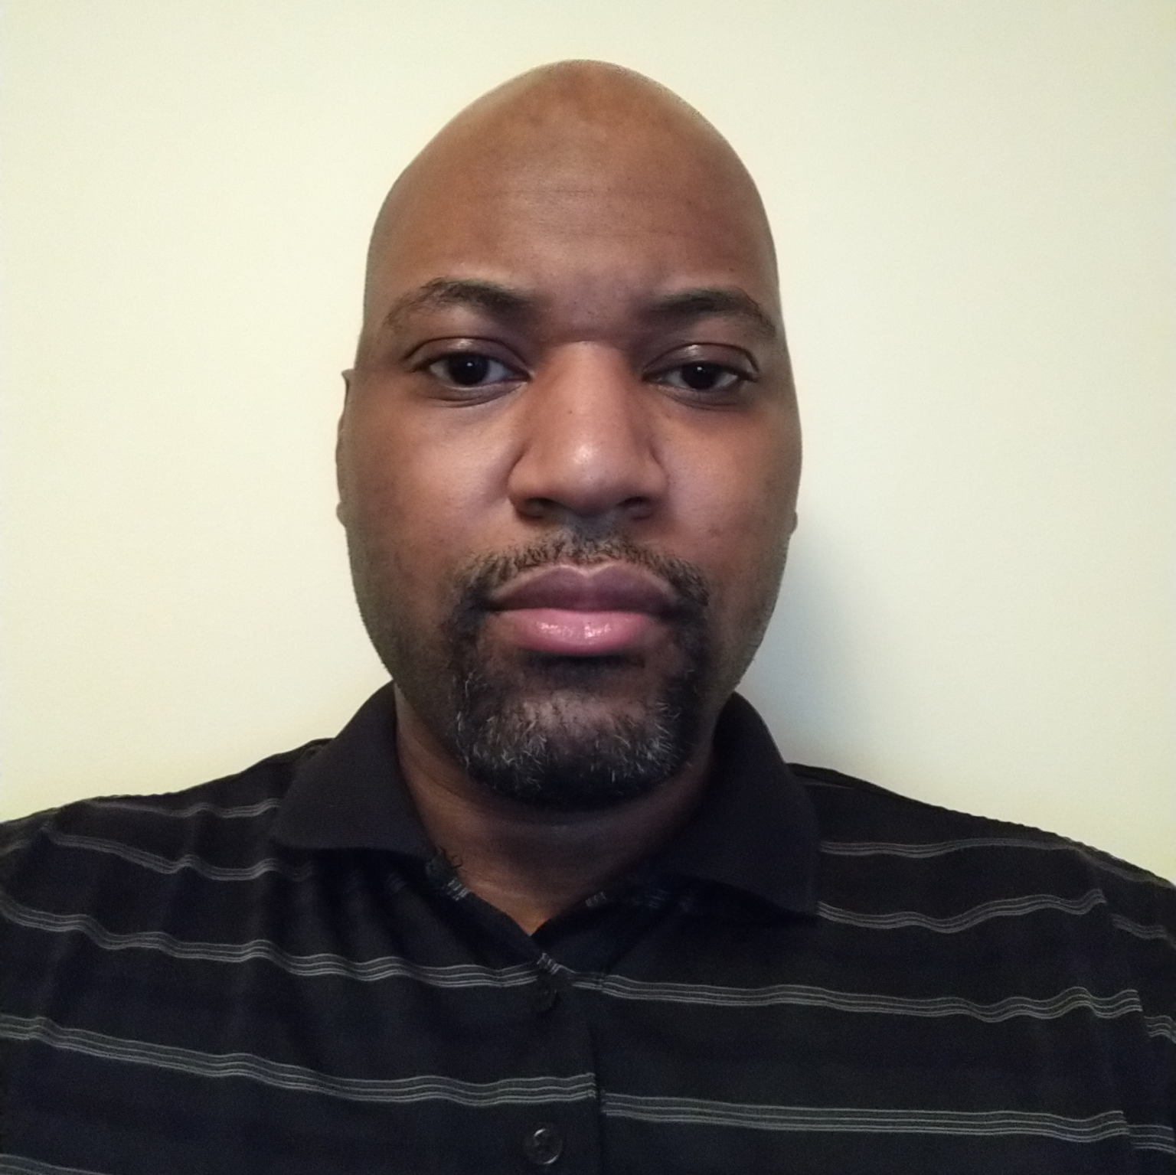

Mission Statement
-We stop at nothing to make sure your data sticks to its roots
Jared
Ian
Huy
Ali
Alex
Compliance
Polished GUI
ToS
Liability
Documentation
Presentation
Organization
Website
Github Repo
Growth
Data extraction
Back-End
Integration
Visualization
Structured GUI
Front-End

Slide 3
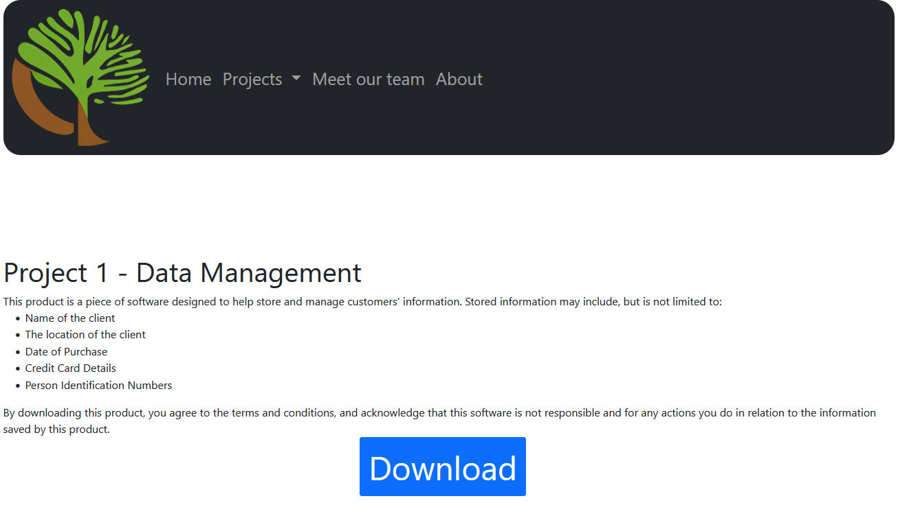
Our First Issue: The website
HTML, CSS, JavaScript
Other languages used
Going forward
Amazing growth

Slide 4


The second issue: data extraction
CSV, Pickle
Back-end
How we used the libraries
Coding reviews
Improvements

Slide 5

Third issue: compliance
PEP-8 standards
ToS
Liability

Slide 6

Fourth Issue: Data Visualization
Structure
Starting point
Visually appealing

Slide 7
Fifth Issue: Database Integration
Front-end To Backend
Splitting code into classes
Organizational standards

Slide 8



Add a Slide Title
Timeline
The Final Product!
-Weekly coding
meetings
Linked front-end to back-end Finished Testing Finishing Touch
-Polishing
back-end
-Kanban
tool
Tasking
First drafts
Revisions
Polishing
The Final Product!
Creating the GUI
Back-end compliance
Privacy policy
Added GUI

Slide 9
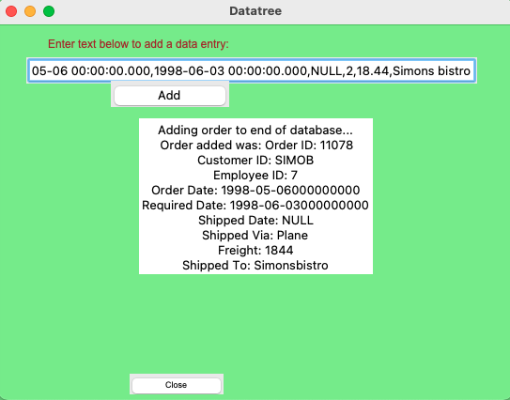
How does it work?
Adding an order:

Slide 10
Add Random entry
Delete Last Entry

Slide 11
Order Filled By Employee Search
Order Fulfillment Date

Slide 12
Customer ID Search
Search Order ID

Slide 13
Ship Date Search
Shipping Method

Slide 14
Shipping Courier
Search Order Date

Slide 15
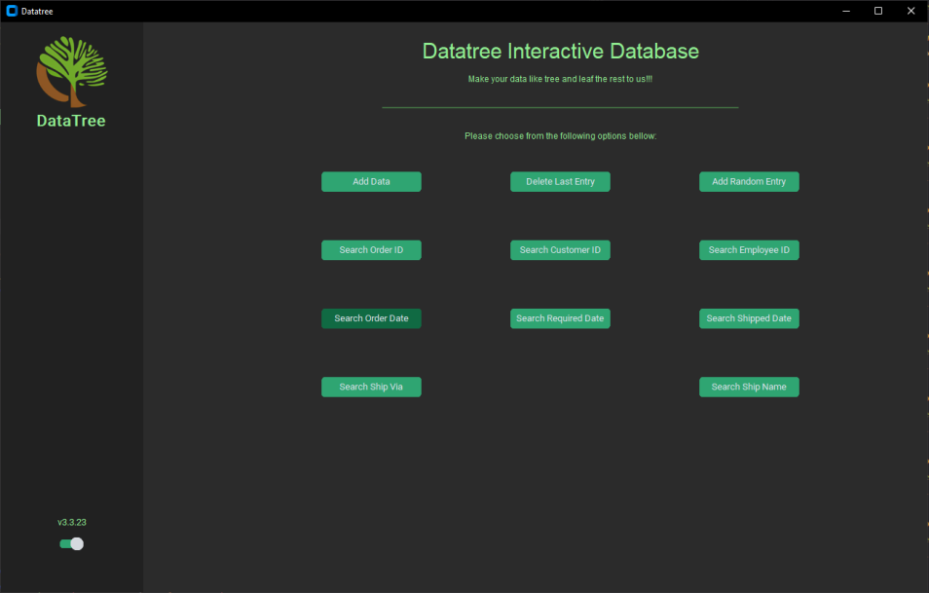
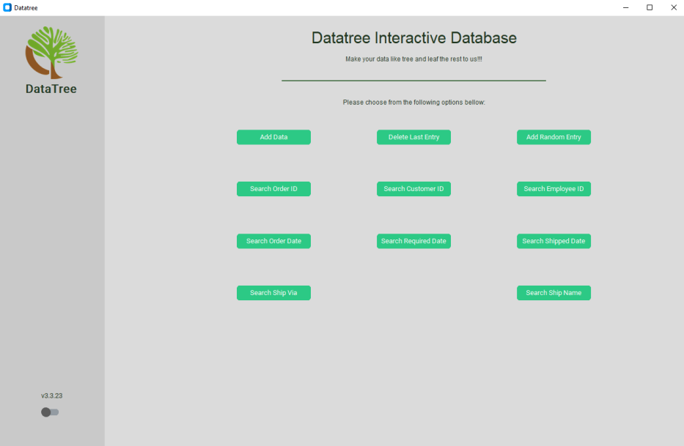
New UI update!!!
Dark Mode
Light Mode

Slide 16
Live Demo Here

Slide 17

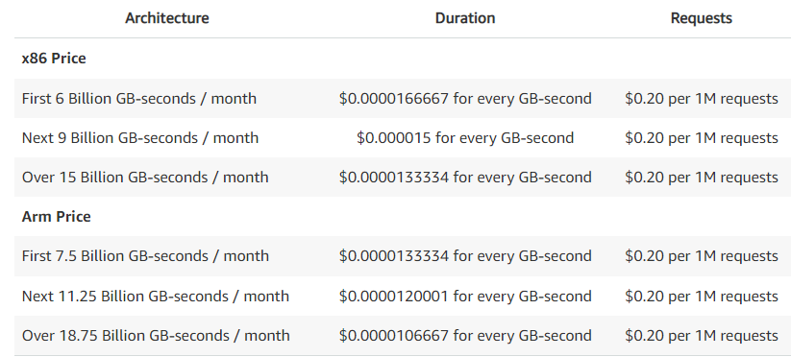
Pricing
Affordability
Sustainability
Modularity

Slide 18
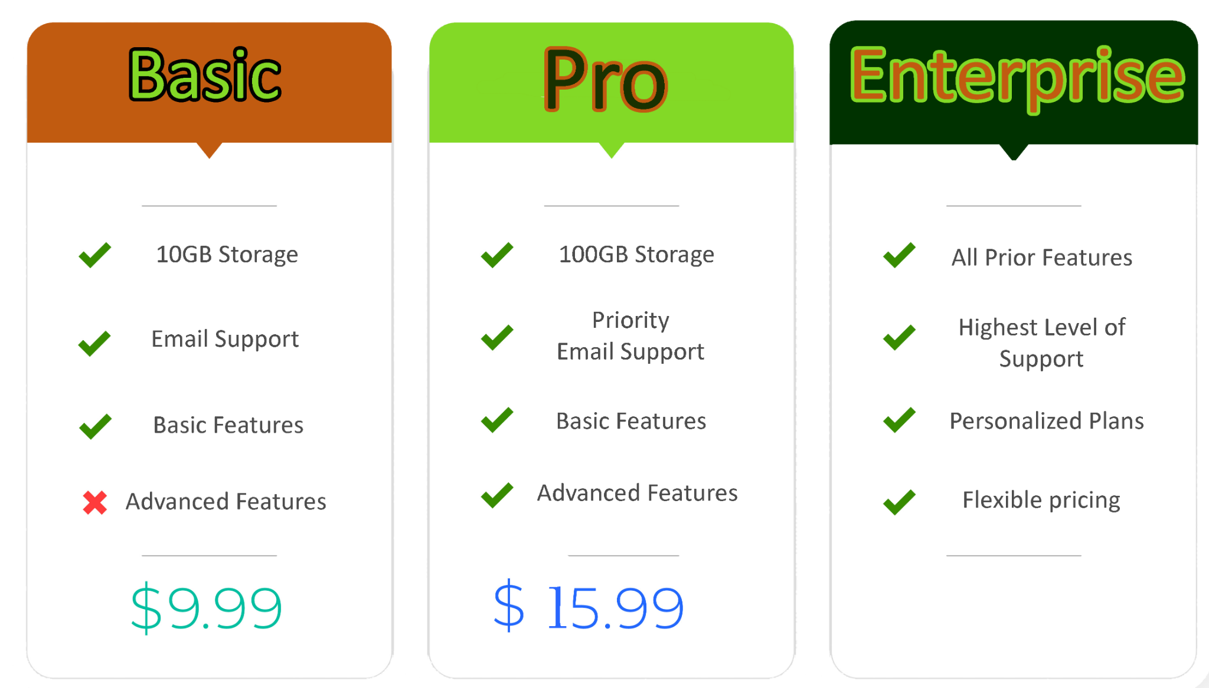
Plans

Slide 19

More coming soon…

Slide 20
Works Cited
Python enhancement proposals. PEP 8 – Style Guide for Python Code. (n.d.). Retrieved March 5, 2023, from https://peps.python.org/pep-0008/
Amazon Web Services. (n.d.). AWS Lambda Pricing. Retrieved March 7, 2023, from https://aws.amazon.com/lambda/pricing/

